Slide 1
Keep up with NOW! Automate rebuilding your (home)lab on steroids
Ralph Eckhard – Sven van Rijen

Slide 2
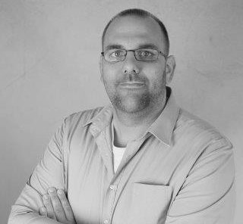


Ralph Eckhard
Senior IT Consultant
@ralpje

Slide 3
Modulair building Treat your lab as Lego
Hardware: the baseplate
Windows Server + Powershell: the bricks
What you deside to do with it: the building
@ralpje

Slide 4
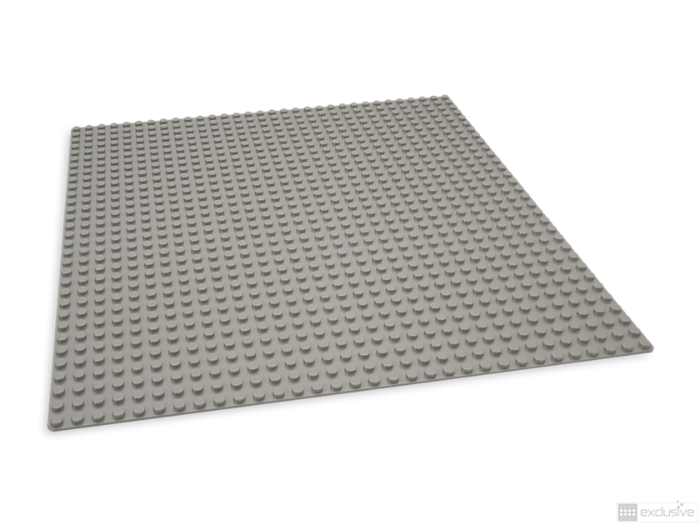
The hardware
@ralpje

Slide 5
The hardware Demands and wishes
Small and mobile
Plenty of RAM
Enough IOPS
Tight budget ;)
@ralpje

Slide 6
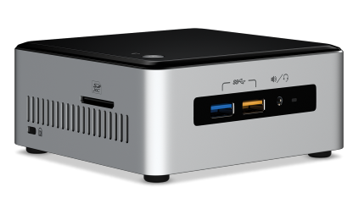
The hardware My choice
Intel NUC 6th gen Core i5-6260u
M.2 PCiE-slot and SATA-600
Max 32GB DDR4 SoDIMM RAM
NUC + 2x16GB + 240GB SSD: ca €800,00 incl VAT
@ralpje

Slide 7
The basics Demands and wishes
Hypervisor as base OS
Management using known tools
Separate networking
Ease of rolling out new VM’s
Nested virtualization
@ralpje

Slide 8
The basics My choice
Windows Server 2016 as base OS
Known management
Use of GUI possible (if you would feel the need)
NAT vSwitch
Powershell for scripting
@ralpje

Slide 9
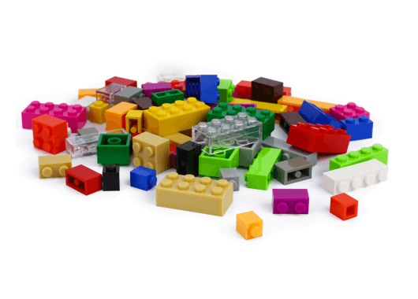
The bricks
@ralpje

Slide 10
Saving on storage
Differencing disks
Create a VM and use this as the base disk for all your new VM’s
@ralpje

Slide 11
Networking
The best of an external and internal vSwitch combined
Isolated and independent from the host
Internet access through the host
Portmapping possible
@ralpje

Slide 12
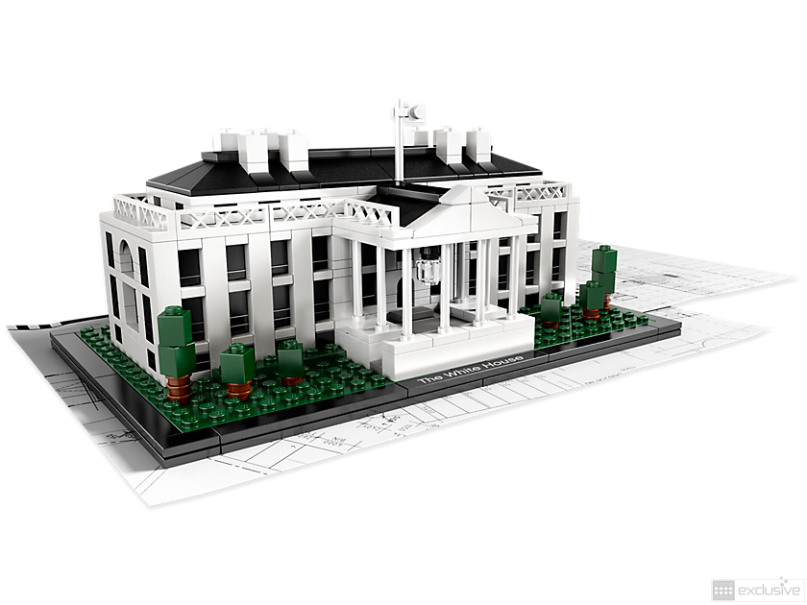
Let’s build!
@ralpje

Slide 13
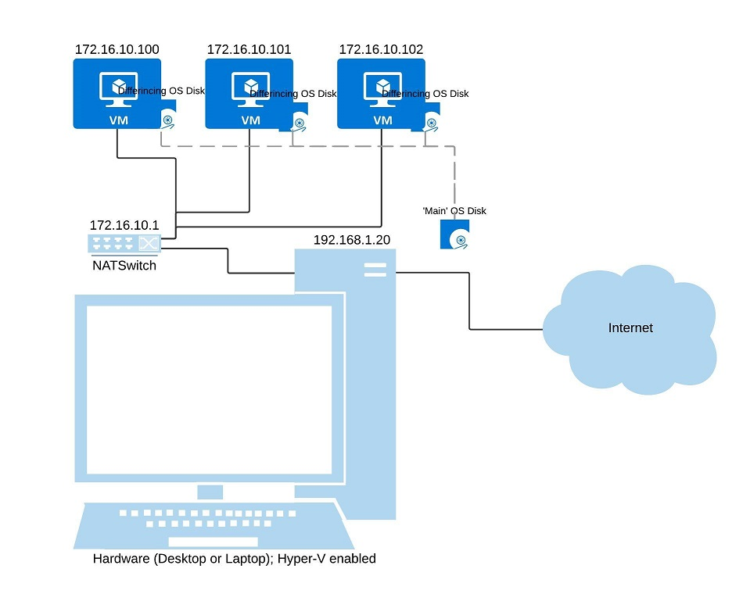
The big picture
@ralpje

Slide 14
Networking
Create a new ‘internal’ vSwitch
Assign a static internal IP
Set up NAT for this switch
@ralpje

Slide 15
Steps for rolling out a new VM
New disk based on differencing disk
New VM on this disk
Import and edit the unattend.xml and copy this to the new VM
Start the new VM
@ralpje

Slide 16
Converting script to a function
Use the new-NATSwitch cmdlet to create both the internal switch and corresponding NAT network.
Use the new-labvm cmdlet to roll out a new VM
Create multiple new VM’s by using a CSV-file
@ralpje

Slide 17
Networking: inbound traffic
Create a new static mapping, using internal and external port numbers
Correctly set the firewall for the guest machine
@ralpje

Slide 18
After rolling out
Manage your guest from the host server using PowerShell Direct
@ralpje

Slide 19
Nested Virtualization
Windows 10 Anniversary Update or Windows Server 2016 for both host als guest
No possibility for dynamic memory
Hyper-V VM version 8 or up
Intel Processor with VT-x and EPT
MAC Address spoofing or NAT
@ralpje

Slide 20
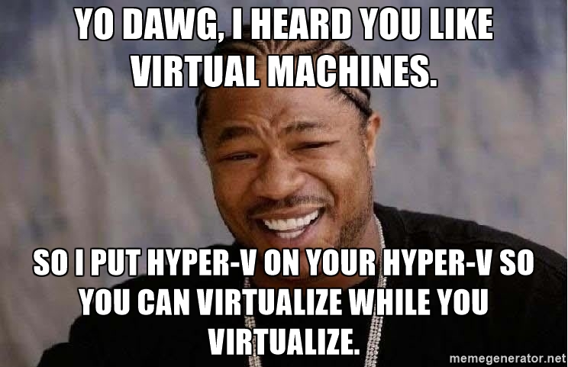
Nested Virtualization
@ralpje

Slide 21
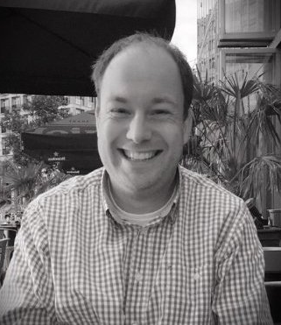

Sven van Rijen
Senior Engineer
Twitter: @svenvanrijen
Blog: www.svenvanrijen.nl
@svenvanrijen

Slide 22

And now, bring on the steroids ☺
@svenvanrijen

Slide 23
Adding purpose to the VM’s
VM’s are ‘empty’ up till now
Still a lot of manual tasks to perform to build an AD environment for instance
Why not automate that?
@svenvanrijen

Slide 24
How to automate
Use Azure Automation DSC
Free up to 5 nodes
Initialy, no on-premises infra needed (unless you want use more than 5 nodes)
@svenvanrijen

Slide 25

New bricks added
An Azure subscription
Free trail/pay-as-you-go/MSDN/SA-contract/etc.
The AzureRM PowerShell module
An automation account within the subscription
A DSC config to upload and compile
A DSC metaconfig to ‘onboard’ the machine to AzureDSC
@svenvanrijen

Slide 26

Let’s pray to the Demo Gods
@svenvanrijen

